Slide 1

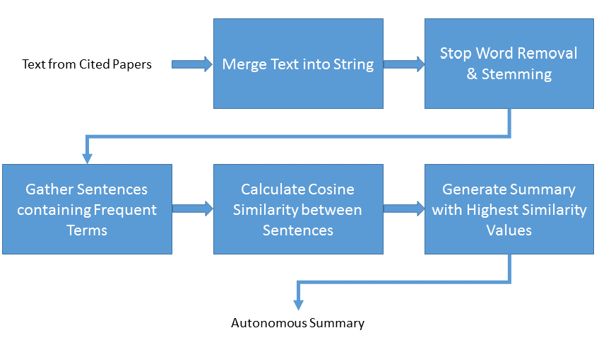







Citation-Centered Text Summarization
Nicholas Alexander (Advisor: Dr. Hyoil Han) Weisberg Division of Engineering and Computer Science, Marshall University
Abstract
Methods
Evaluation & Results
In the biomedical domain, papers are published at an astonishing rate. The rate, for a single publisher, was estimated to be roughly 1.5 articles per minute or about 800,000 per year. It is purely impossible for humans to keep up with the amount of papers submitted. Therefore, it is extremely desirable to have an autonomous system that can accurately analyze and summarize new publications. The generated summaries could then be used to classify papers or be used within a publication reader whereby clicking on a citation would display the summary for the cited text or entire cited paper.
Today, two methods of paper summarization prevail: the paper abstract and relevant points from cited papers. The major concern with a publication abstract is that the abstract does not express the long-lasting implications of the paper. For example, the abstract many only summarize the methods and results but may not specify how the results could be used. The flaw with a summary of relevant points from cited text is the lack of context from the original publication. Without reading the cited paper, the reader will not know how that author expressed their claim.
In order to remedy these two drawbacks, the autonomous system should group cited text by facets. Facets refer to the areas of text in a paper - such as the methods, data, results, and conclusion. This would allow the system to cluster text spans of the same facet and improve the summary.
Read in full text of every cited paper for a given reference paper.
Remove words that are not meaningful and occur frequently. Examples of stop words include most prepositions such as ‘of’ and ‘the.’
Reduce all words to their base forms. This reverts all plural words and past-tense words to their singular, present tense base. For example, calculates becomes calculate; calculated becomes calculate; calculation becomes calculate.
Determine the number of times every word is used in the cited text to create frequency distribution. The most-occurring terms are considered important. Gather all sentences in cited text that contain the frequent terms.
Calculate the cosine similarity between each gathered sentence and every other gathered sentence. Because closely related sentences are likely important, high cosine similarity values are desired.
Combine sentences with highest cosine similarity values until 250 words are used – resulting in the autonomous summary.
After applying the cosine similarity measure across all sentences in the cited papers, a 250 word summary was generated by the autonomous system. As part of the supplied training data, there are 4 model, human-written summaries. To evaluate a generated summary, a naïve word-matching metric was used to compare the generated summary to the model summaries.
Training Data Set | Matching Words | Total Words in Model | Match Ratio
1 | 264 | 281 | 94%
2 | 58 | 136 | 43%
3 | 58 | 161 | 36%
4 | 256 | 260 | 98%
5 | 104 | 218 | 48%
Challenges
Algorithm is very time and memory inefficient
Undesired words, such as author names and citations, appear in autonomous summary
Porter stemming algorithm does not perfectly reduce all words
De facto standard evaluation system ROUGE could not be used
Technologies

